Slide 1
What combination of courses can I tudy in the department?
A Level Computer Science + BTEC IT
BTEC Computer Games Development and Cyber Security + BTEC IT

Slide 2
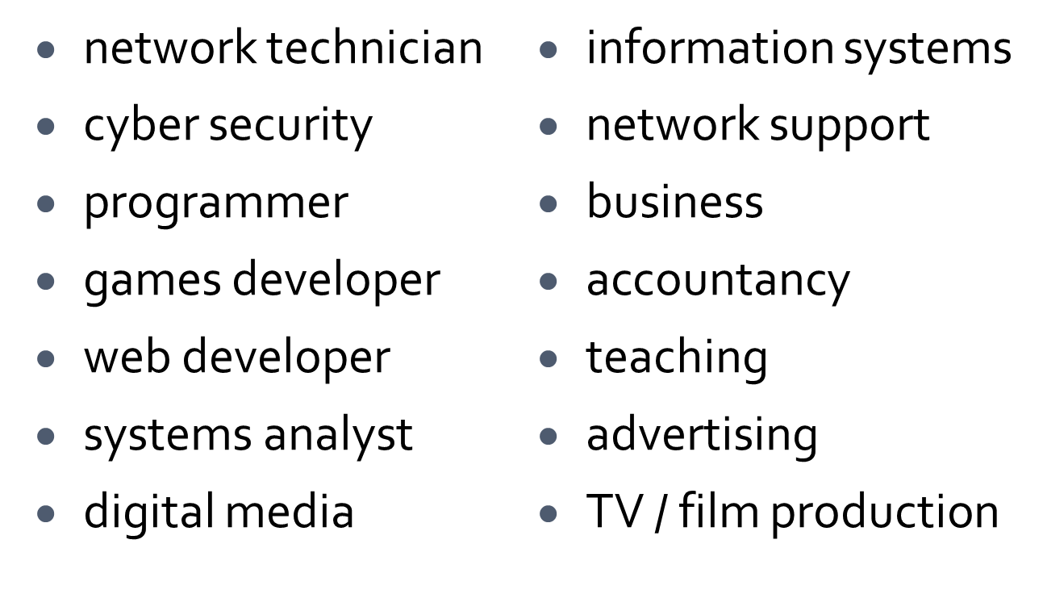
Progression
A wide range of degree courses, apprenticeships and careers:

Slide 3
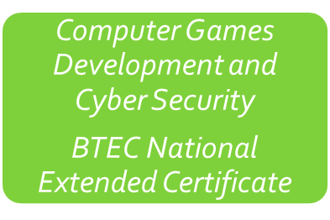
Computer Science and IT Department
Summary
Computer
Science A Level
Information Technology
BTEC National Extended Certificate
Highly respected, academic A Level
“Essential” for some Comp Sci degree courses
Mix of theory and practical work
80% examination
20% coursework
Grade 5 (or B) in GCSE Maths
Practical and relevant using industry standard software
42% coursework
58% written exam/computer-based task
Equivalent to 1 A Level
Progression to HE or employment
Grade 4 (or C) in GCSE Maths
Practical and relevant using industry standard software
42% coursework
58% written exam/computer-based task
Equivalent to 1 A Level
Progression to HE or employment
No additional entry requirements
Information Technology and either Computer Science or Computer Games Development and Cyber Security can be taken alongside each other
Notes:
Our department offers three courses with two very different methods of assessment to suit the range of students’ abilities and interests.
Firstly the new BTEC L3 Computer Games Development and Cyber Security will provide a high quality course using industry standard tools and programming languages (Unity and C#).
Secondly the A Level in Computer Science with OCR will provide a highly respected academic qualification assessed mainly through written examinations with 20% coursework.
Thirdly the BTEC Level 3 Extended Certificate in Information Technology with Pearson provides a highly respected vocational qualification involving a large amount of non-exam assessment for those students who wish to focus on IT and using software rather than programming.

